Slide 1


Data Analytics Fundamentals
Fundamentos de Análisis de Datos
Connect Session #1
07/12/2020

Slide 2

Welcome to Udacity!
Where your journey into the data world begins!
Notes:
….

Slide 3

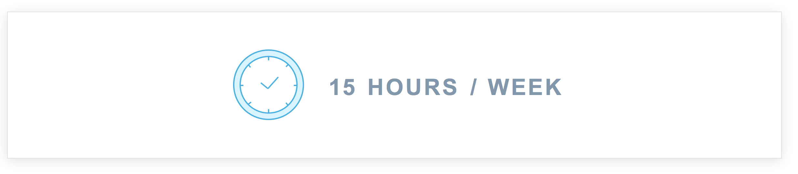
What do we expect from you?
During the week, you are expected to work an estimated from 10 - 15 hours on your Nanodegree classroom program on your own so that you are prepared for the following week’s session.
You have to watch your ND videos in your classroom, to start all you have to do is to log into your classroom.udacity.com and get started your learning journey on the class right away.
Watch this video to know more about your classroom experience.

Slide 4




Learning objectives
Learn programming skills needed to uncover patterns and insights in large data sets.
Time:
4 months
Skill level:
Intermediate
Tools Used:
SKILLS
COURSES
PROJECT PORTFOLIO
Investigate a dataset using Python data analysis packages
Gather, assess, and clean data for analysis
Manipulate data in a database using SQL
Introduction to Python
Introduction to Data Analysis
Data Wrangling
Introduction to SQL
Explore Weather Trends
Explore US Bikeshare Data
Investigate a Dataset
Wrangle and Analyze Data
Investigate a Relational Database

Slide 5

We want to know you!
What is your name?
What do you do?
Why Data?

Slide 6

Key definition:
DATA ANALYSIS
05
Communicate
04
Draw Conclusions
Data is defined as distinct pieces of information. Data comes in different forms: numbers, text, images, audio, video…
Data Analysis is a process of inspecting, cleaning, transforming and modelling data with the goal of discovering useful information, informing conclusions and supporting decision-making.
03
Explore
02
Wrangle
01
Question
?
Q: Where do Analysts spend most of their time?

Slide 7
What is Data Science?
“The art of processing and learning things from data”
Interdisciplinary field” - Data science is inherently broad, with elements of statistics, programming and business.
About processes and systems - This makes data science different from statistics. It’s not just about results - it’s about processes and systems.
To extract knowledge or insights from data – This is what makes data science different from software engineering. It’s not just about systems, it’s about learning something.
In various forms, either structured or unstructured – Again, statisticians don’t traditionally work with all the forms of data that data scientists use.
Which is a continuation of some of the data analysis fields such as statistics, data mining, and predictive analytics, similar to Knowledge Discovery in Databases – Reiterating that data science is interdisciplinary. One of the key distinctions of data science is that is uses skills from programming and statistics.
“Data for Decision Making”

Slide 8
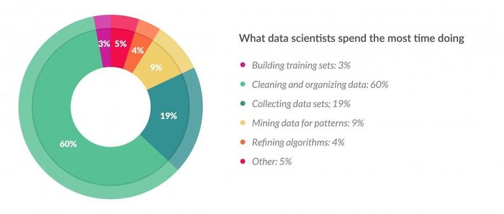
What do you need to learn?
Dealing with unstructured, messy and big datasets is a key skill, and finding trained analysts who are able to deal with such data is a major business problem. As an analyst you’ll spend most of your time data cleaning, and so being trained in how to do this is a key skill.

Slide 9

Preparing your start
Best practices
Notes:
….

Slide 10

Asking questions?
Asking for Help
“There are no silly questions, it’s just silly who doesn't ask”
Explain the problem as clearly as possible.
What did you expect to see? What are you seeing instead?
What error message are you seeing (if any)?
What was the last thing you changed or added in your code before things stopped working?

Slide 11
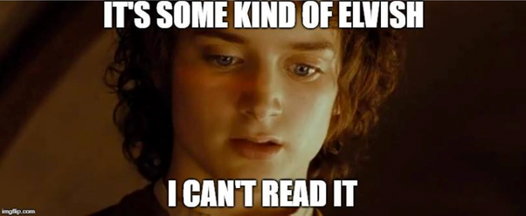
Writing code
Asking for Help
When you trying to look at the code you wrote a month ago…
When you first start learning to program it can be difficult enough to write code that actually works. Why should you also spend time making your code look good? Well, code style is about much more than looking good.

Slide 12
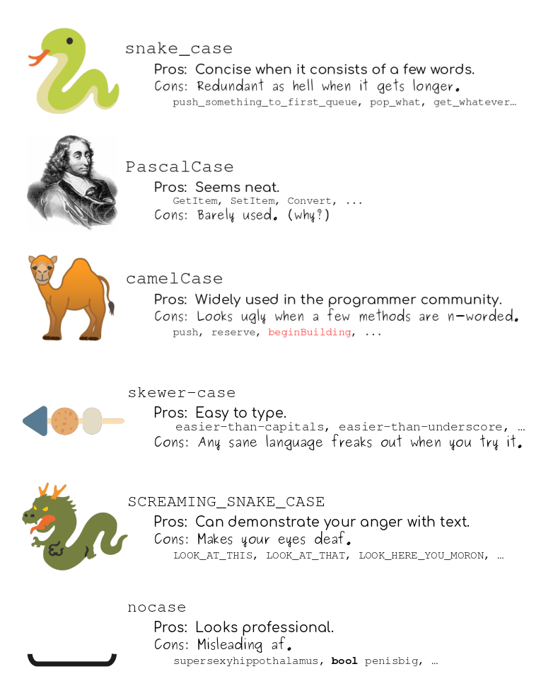
Coding style
Asking for Help

Slide 13
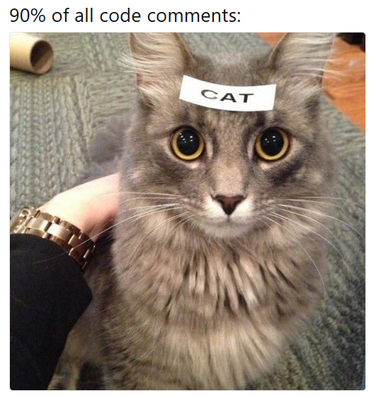
Commenting code
Asking for Help
Places to include comments:
Explaining why you’ve done things a certain way
Explaining the results of an analysis in a script
Explaining a particularly confusing line of code
90% of all code comments are unnecessary

Slide 14

Community

Slide 15
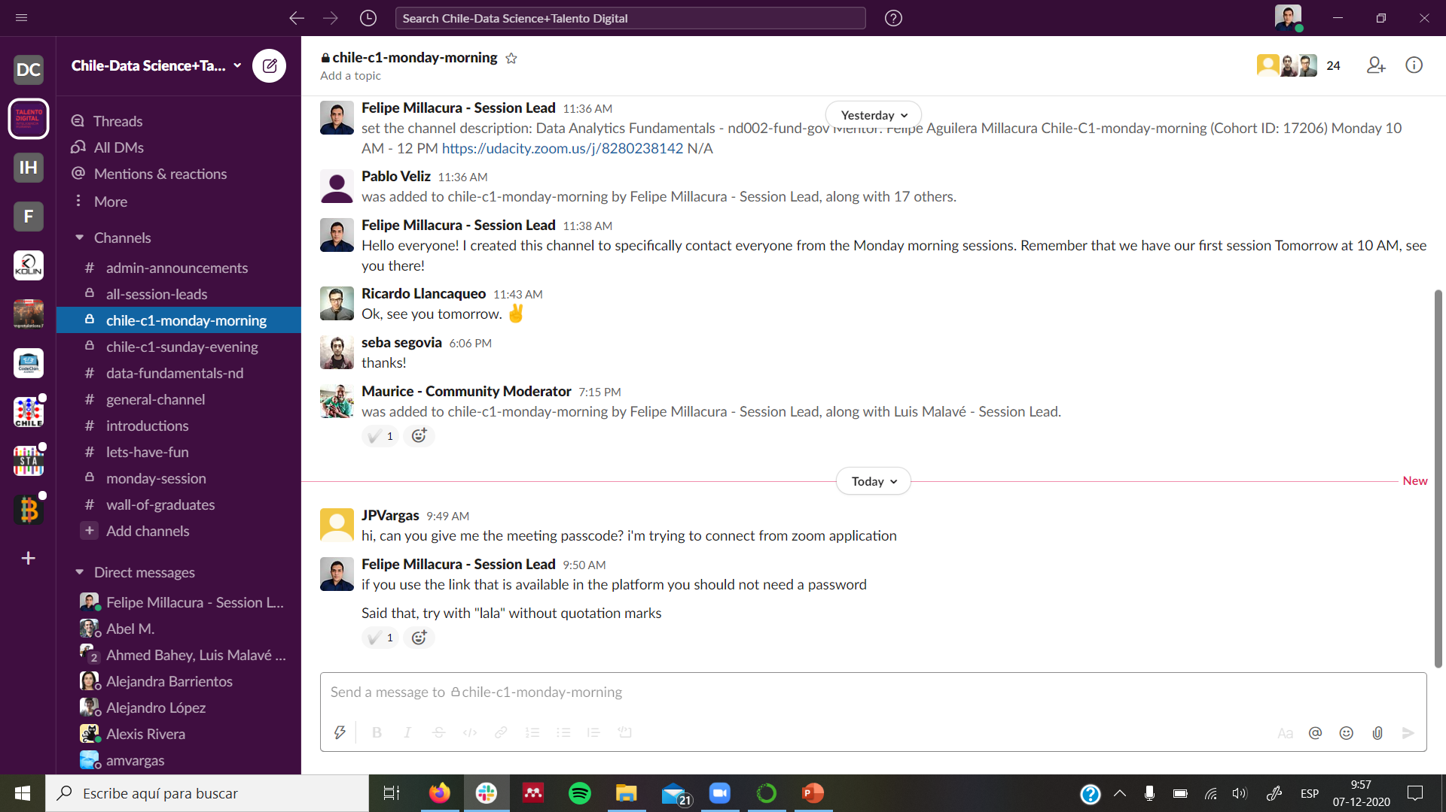

Communications
Asking for Help
PLEASE make sure you use the same email address as the one you used to create your Udacity account throughout the whole program and across platforms!

Slide 16


Udacity Virtual Connect setup
Asking for Help
C
Typical virtual connect session schedule (~1.5 hours)
10 min
Round the room attendance
10 min
Discussing student progress
70 min
Students activities and roadmap for the coming project
30 min
Student Q&A (optional)

Slide 17

FAQs
Useful Resources

Slide 18
Project Reviews
Every time you submit a project, you will receive in-depth, personalized feedback on your project submission from one of our expert project reviewers. Project review usually take from 2 to 3 days. Once your review is ready, you will get an email to notify you and you will be able to view it. There are three results for the review:
.
Non-gradable
The reviewer was not able to grade your project. You either submitted the wrong files or the files submitted cannot be opened because they are in an unsupported format. You can resubmit your project again from your classroom after addressing these issues.
Requires Changes
You project didn’t meet rubric specifications. the reviewer will highlight which part that requires to be edited so that you pass the project on your next submission. You can resubmit your project again after editing it through your classroom.
Meets Specifications
You've successfully completed the rubric requirements and passed your project.

Slide 19
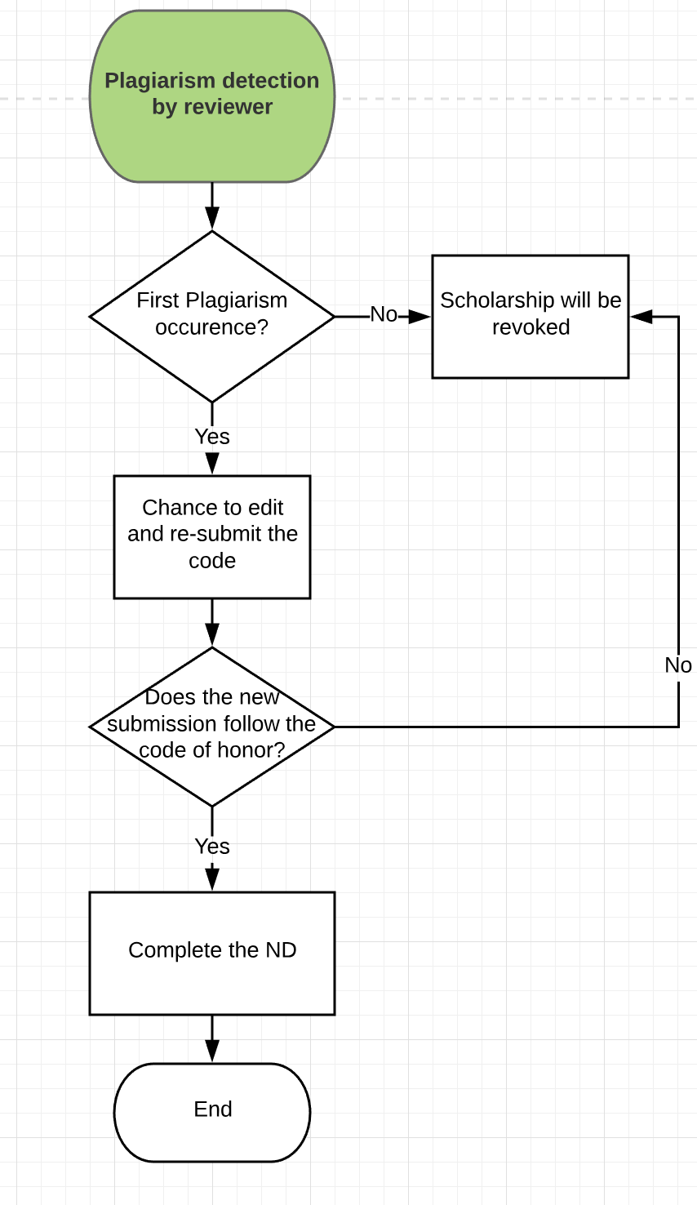


⛔ Be aware of plagiarism, though!
Plagiarism
Project submissions must consist of original work
Submitted projects will be scanned for plagiarism
Students who are found to have plagiarised will risk their Nanodegree being revoked as seen to the right
Read the honor code and the rubric carefully in all projects
Building the future of education
Notes:
Plagiarism will also stop you from applying to any future programs. Make sure the work you submit is your own, and is not taken from own sources on the internet. Please also make sure you work on your projects alone (i.e. do not submit the same answers as your peers)

Slide 20

Revoking Warning
To avoid the risk of getting revoked from your Nanodegree and losing your scholarship, make sure you:
Submit your first projects on time and stay on track.
Attend your weekly Connect Session because attendance is mandatory.
Follow your weekly schedule and make the necessary progress in your classroom.
Follow the the rules above to avoid losing your scholarship in the revoking cycle that will happen by the end of the 3rd week of this scholarship.
Tip: Project reviewing might take from 1 to 3 days. We highly encourage you to try to submit your project as soon as you can and not wait until the last minute.

Slide 21
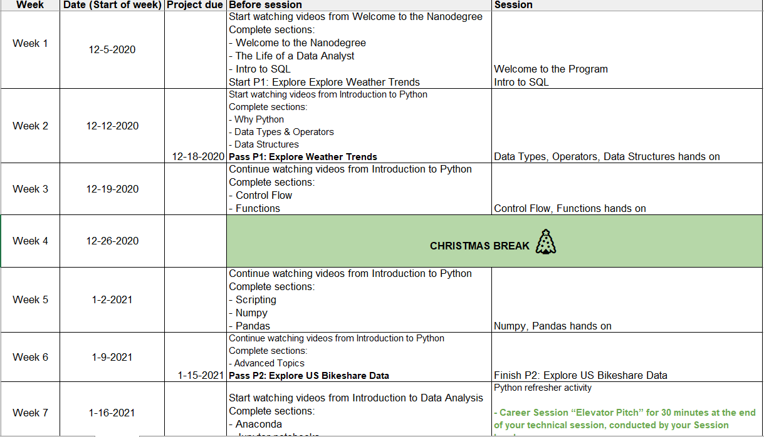
Weekly schedule

Slide 22
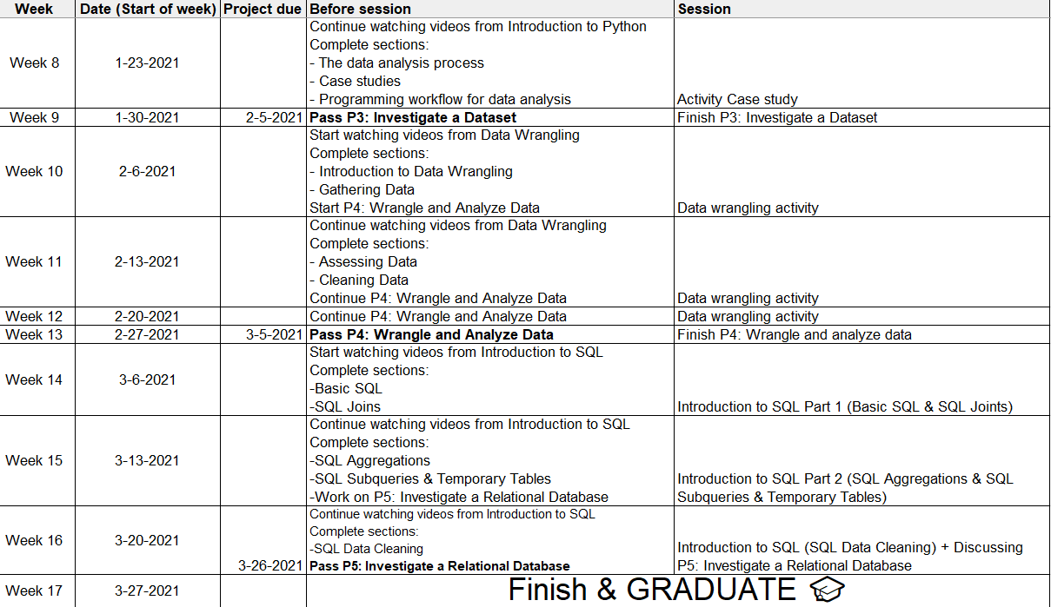
Weekly schedule

Slide 23
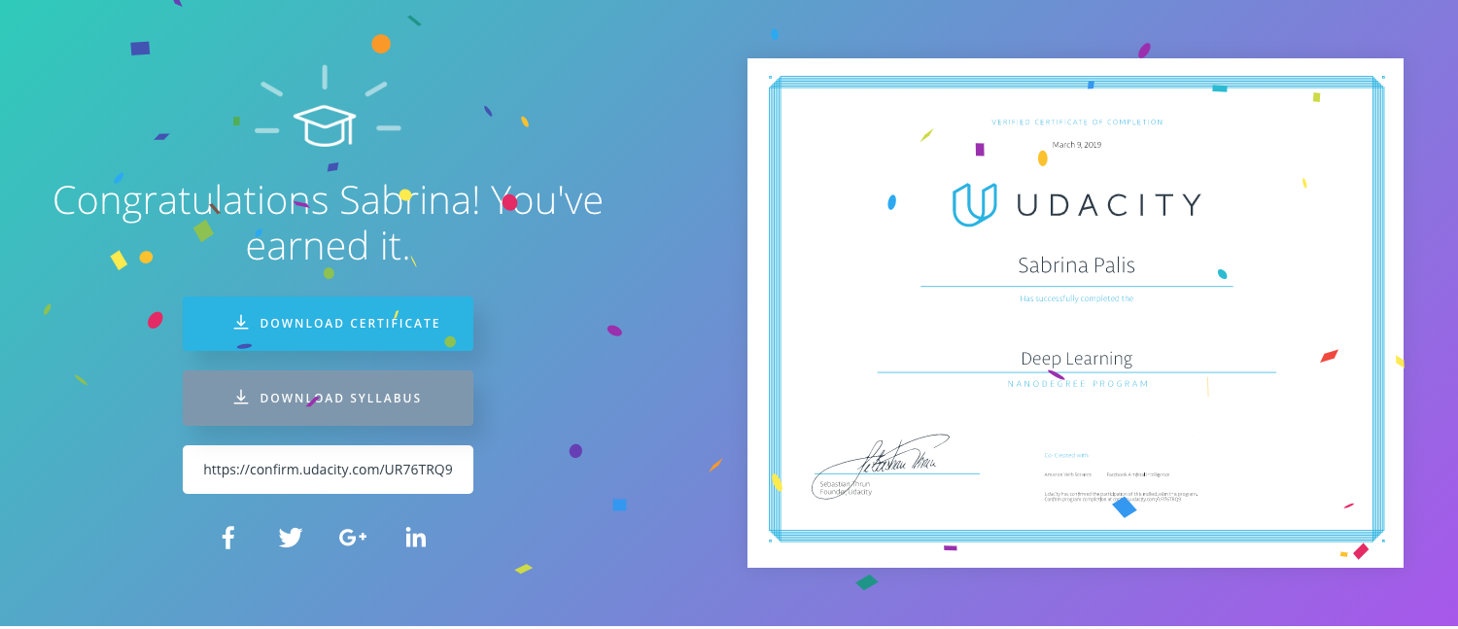
The end goal! 🚀

Slide 24

Udacity Team wishes you a very successful Learning Journey

Slide 25

© 2020, Udacity. All rights reserved.

